Slide 1
Relational Model
Instructor: Kazi Amit Hasan

Slide 2
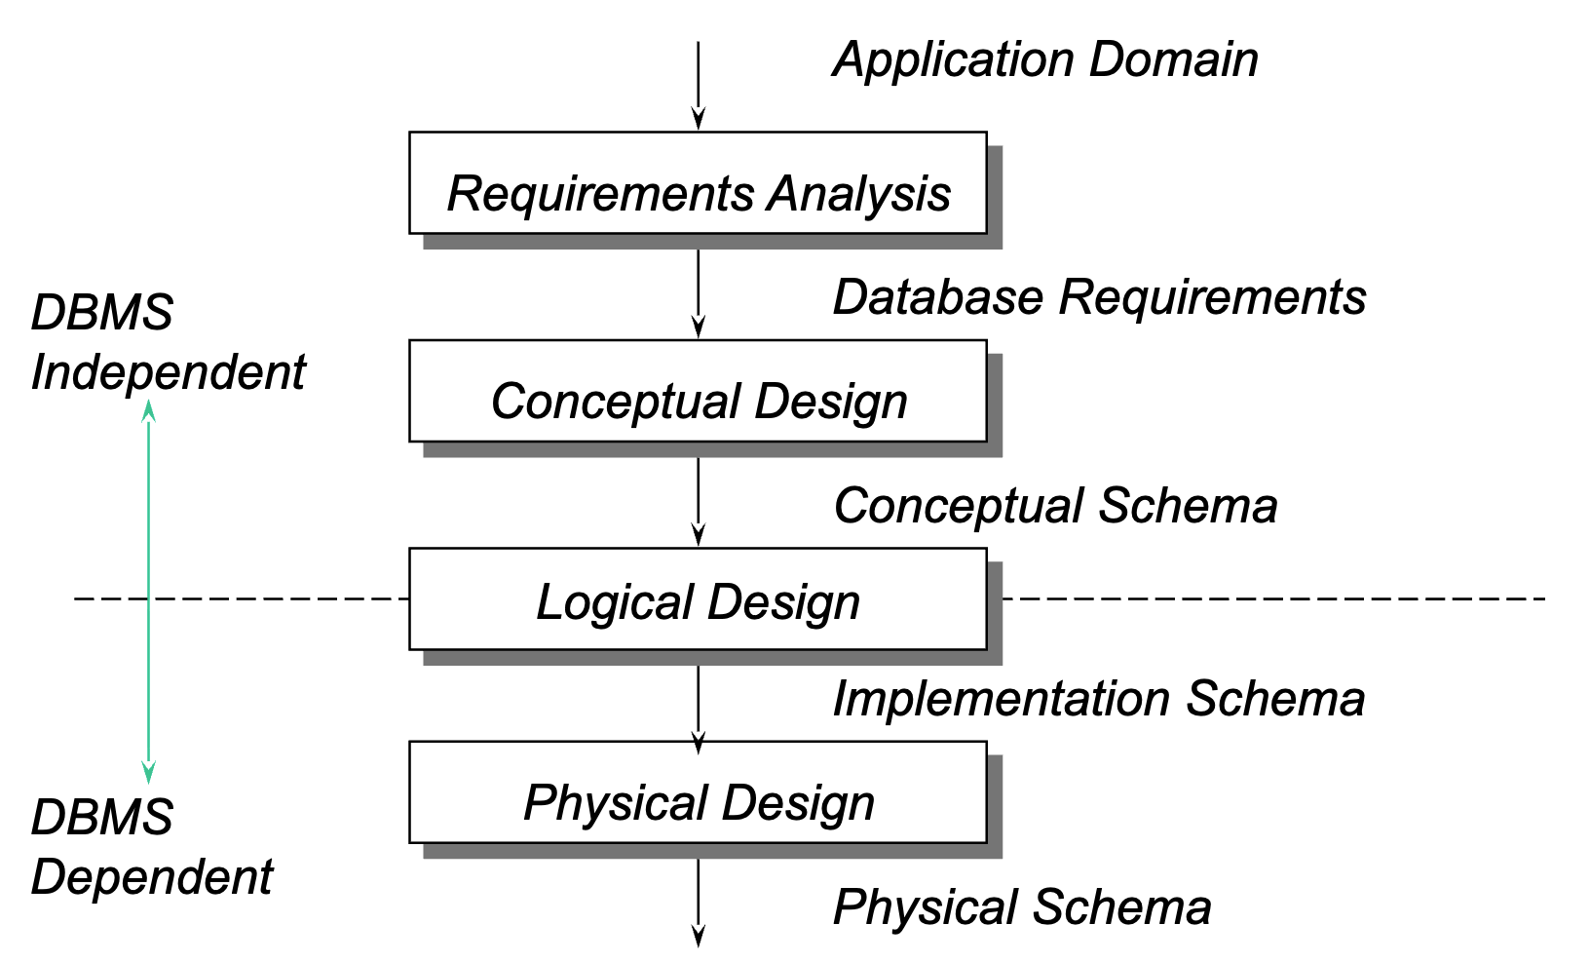
Phases of Database Design

Slide 3
Relational Model History
Introduced by Ted Codd in 1970 in a classic paper
Laid the foundation for database theory
Also won Ted Codd the ACM Turing award!
Many (in fact, most) database concepts & products based on this model
MySQL, DB2, Oracle, Informix, PostgreSQL, MS Access, Pardox, SQLServer ..

Slide 4
Relational Model
Relational Model represents how data is stored in Relational Databases. A relational database stores data in the form of relations (tables)
After designing the conceptual model of database using ER diagram, we need to convert it in the relational model which can be implemented by any RDMBS languages
RDMBS languages: Oracle, SQL, MySQL etc

Slide 5
Relational Model
Relational model can be represented as a table with columns and rows
Each row is known as a tuple
Each table of the column has a name or attribute

Slide 6
Relational Schema
Specifies the table names (relations), the attributes, (maybe the domains), the primary keys and the foreign keys
Customer(CustomerID, Name, Email)
Order(OrderID, OrderDate, CustomerID)

Slide 7
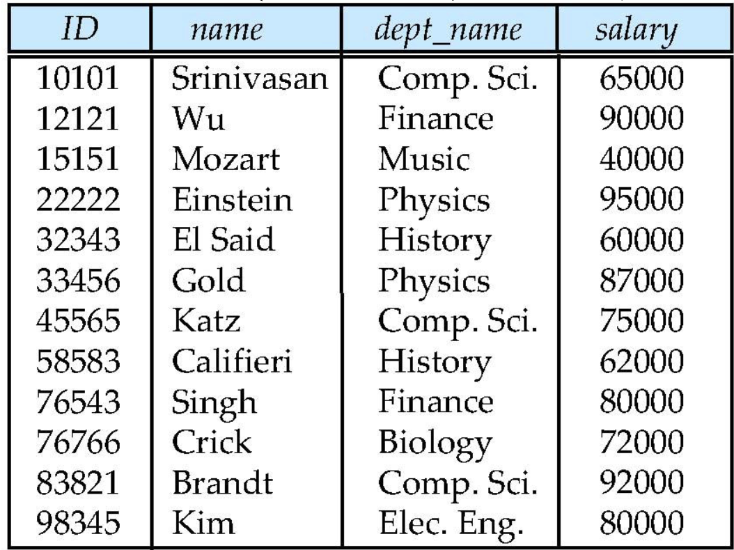
Example of a Relation
What are the attributes?
What are the tuples?
Instructor relation

Slide 8
Relational Model Concepts (Domain)
A domain is the set of allowable values for an attribute
A domain has a logical definition
Canadian phone numbers: 10 digits numbers are valid in Canada
Data types:
Char (10): string of exactly 10 characters
Varchar(50): strings upto 50 characters
Integer:
Float:
etc

Slide 9
Characteristics of a Relation
Each cell contains only one value (not a set of values)
Each column has a distinct name:
StudentID, Name, Major, Age
Values in a column are from the same domain
StudentID: int
Age: int
Name: string
StudentID | Name | Major | Age
101 | Alice | Computing | 20
102 | Bob | Mathematics | 21
103 | Carol | Computing | 22

Slide 10
Characteristics of a Relation
Each tuple is distinct (no duplicates)
Ordering of tuples are immaterial:
Order A: Alice, Bob, Carol
Order B: Carol, Alice, Bob
A database is consists of multiple relations
That is multiple related tables make up a database
StudentID | Name | Major | Age
101 | Alice | Computing | 20
102 | Bob | Mathematics | 21
103 | Carol | Computing | 22
Student relational table

Slide 11
Degree
Degree of relation:
The number of columns
Eg, 5 attributes (columns) >> so degree is 5
Doesn’t usually change (although it can)

Slide 12
Cardinality
Cardinality of relation:
The number of tuples
Changes as new tuples added or deleted

Slide 13
PlayerID | RegID | PassportNo | Email | Phone | Name | Nationality | City | Age
1 | R101 | P8901 | salah@mail.com | 555-1111 | Salah | Egyptian | Liverpool | 32
2 | R102 | P6723 | mane@mail.com | 555-2222 | Mane | Senegalese | Riyadh | 30
3 | R103 | P4456 | gakpo@mail.com | 555-3333 | Gakpo | Dutch | Liverpool | 27
4 | R104 | P9987 | salah2@mail.com | 555-4444 | Salah | Egyptian | Liverpool | 32
Identify the columns
How many tuples?
What’s the degree of relation?
What’s the cardinality of relation?

Slide 14
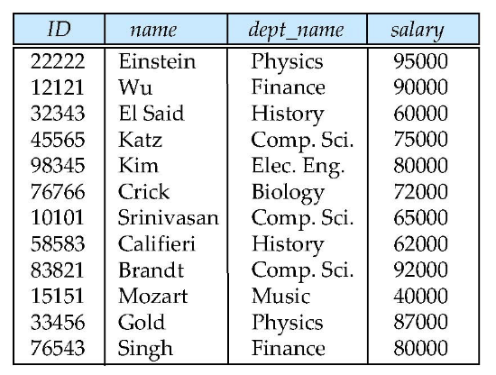
Keys
Relations are sets, implies uniqueness among the tuple
Each row has a value of a data item (or a set of values) that uniquely identifies that row in the table >> called the key

Slide 15
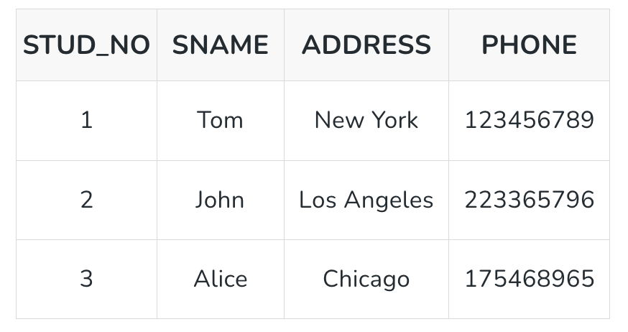
Superkey (from slide ER_Jan12)
A super key is a group of single or multiple keys that uniquely identifies rows in a table.
A super key can contain extra attributes that aren’t necessary for uniqueness.
For example, if the "STUD_NO" column can uniquely identify a student, adding "SNAME" to it will still form a valid super key, though it's unnecessary.
A super key could be a combination of STUD_NO and PHONE, as this combination uniquely identifies a student.

Slide 16
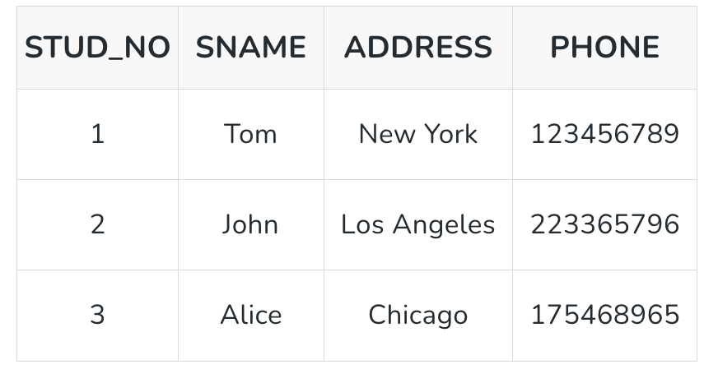
Primary key (from slide ER_Jan12)
A primary key is a unique key, meaning it can uniquely identify each record (tuple) in a table.
It must have unique values and cannot contain any duplicate values.
A primary key cannot be NULL, as it needs to provide a valid, unique identifier for every record.
Databases typically store rows ordered in memory according to primary key for fast access of records using primary key.
The primary key for each entity is underlined in the ER mode
STUD_NO is a primary key

Slide 17
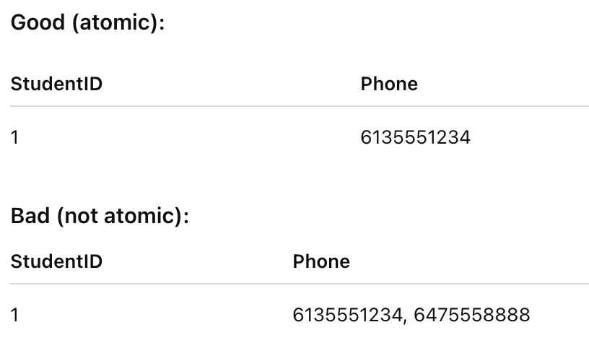
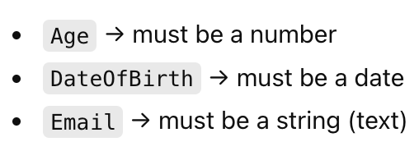
Data Values
All values in a cell are considered to be atomic
each value must be from the specified domain for the column
null values represent values that are either:
unknown, unavailable or not applicable to certain tuples
null values can be restricted for certain attributes
no primary key attribute can contain NULL values

Slide 18
Foreign Key
Order ID | Customer Name | Address | Phone
1 | Salah | 1 Division St | 555-1111
2 | Mane | Albert St | 555-1112
3 | Messi | Downtown | 555-1113
4 | Salah | 1 Division St | 555-1111
5 | Salah | 1 Division St | 555-1111
What’s the problem here?

Slide 19
Foreign Key
Referencing relation (Child)
Referenced relation (Parent)
Orders
Order ID
Customer ID
Product
Customers
Customer ID
Name
Address
PK
PK
FK
FK originates from Customer’s table
What kind of relationship is this?

Slide 20
Foreign Keys
Used to specify relationships among tuples in two relations:
The referencing (child) relation and the referenced relation (parent)
Tuples in the referencing relation have attributes called Foreign Key attributes that reference the primary key attributes of the referenced relation

Slide 21
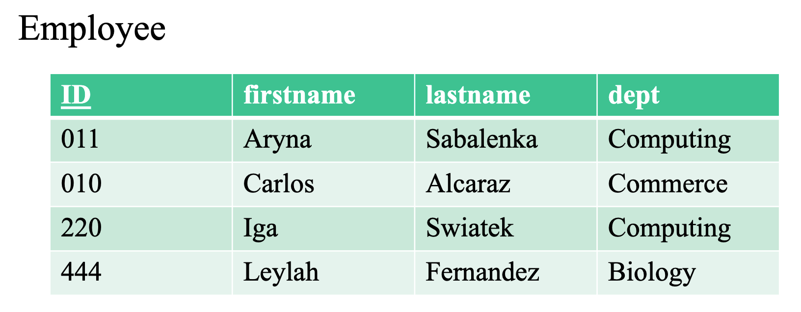
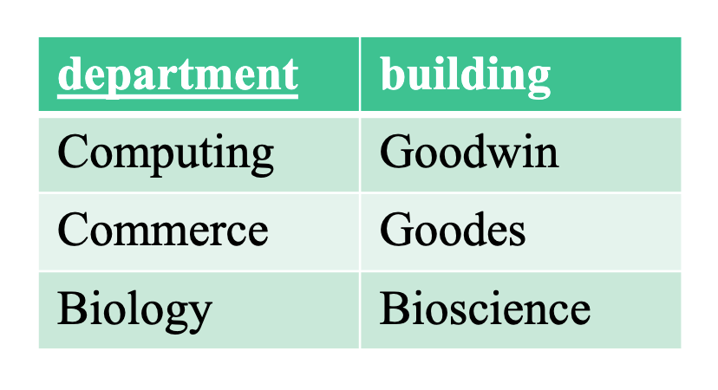
dept is a foreign key referencing departmentName (the primary key of department)

Slide 22
Foreign Keys
a foreign key can be null
a person could have no department association
a foreign key does not have contain unique values
many people can be associated with the same department
the foreign key attributes must come from the same domain as the referenced primary key attributes

Slide 23
A foreign key can refer to its own relation
A foreign key can refer to its own relation.
Ex: Customers can refer other customers
customerID = unique ID of the customer (PK)
referredByID = the ID of the customer who referred them (FK to the same table)
customerID | name | referredByID
101 | Amina | NULL
102 | Carlos | 101
103 | Leylah | 101
104 | Sam | 102
Customer.referredByID (FK) → Customer.customerID (PK)

Slide 24
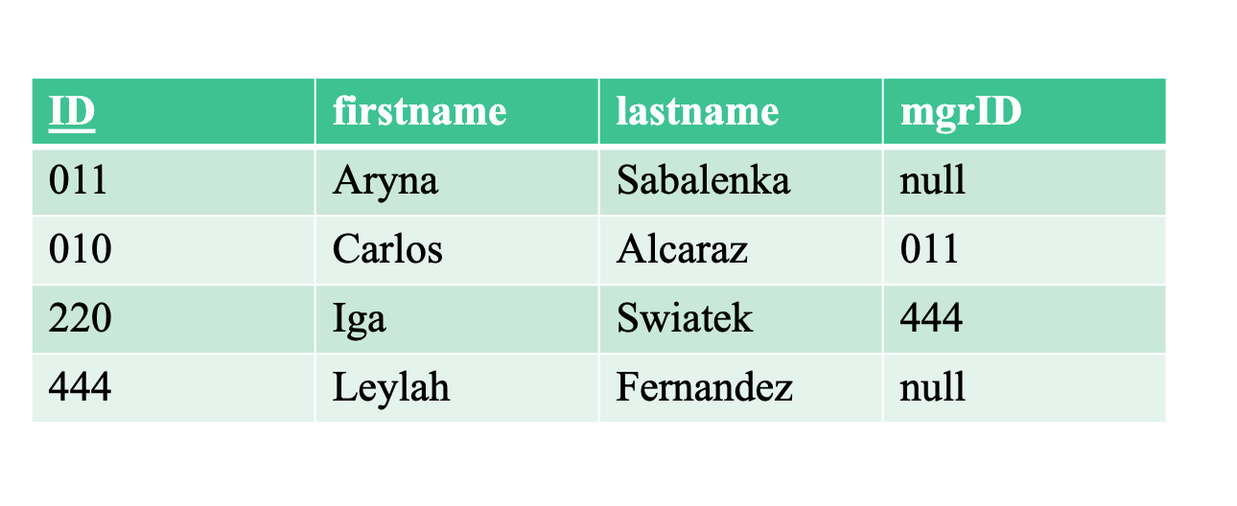
mgrID is a foreign key referencing employee

Slide 25

What does FK do?
maintains database integrity
allows us to make connections between relations
can ONLY enter valid values for dept ((departments that exist in the database))

Slide 26
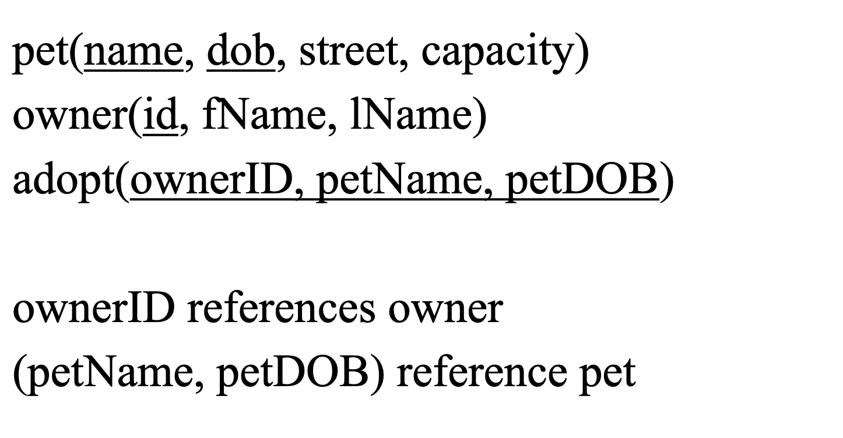

Slide 27
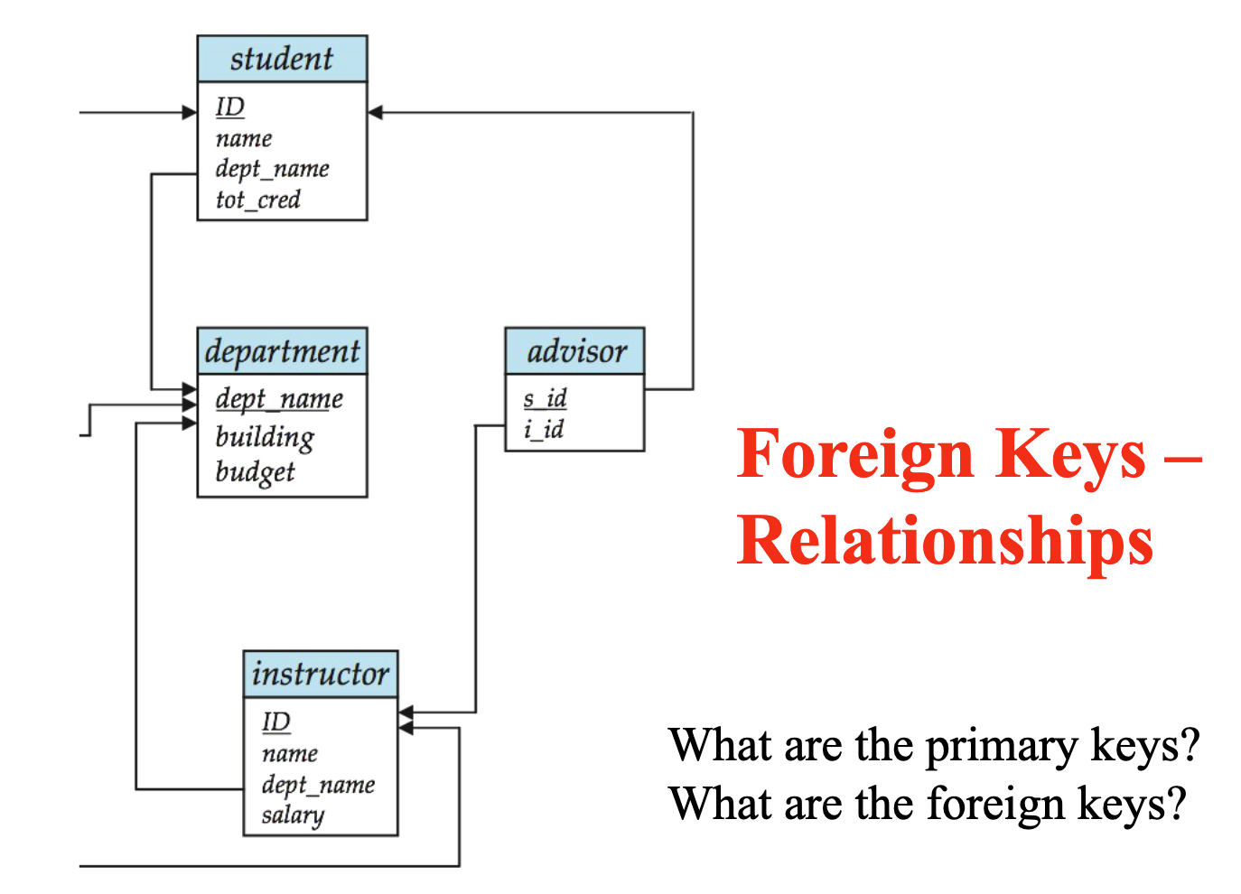

Slide 28
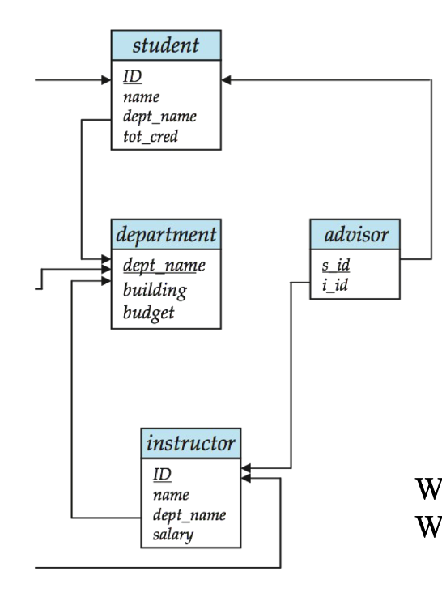
Solve
Parent table = the table being referenced (it owns the PK).
Child table = the table that stores the FK (it depends on the parent).
Department ↔ Student
Parent: department (because dept_name is its PK)
Child: student (because it stores dept_name to refer to department)
student.dept_name (FK) → department.dept_name (PK)
every student must belong to a valid department

Slide 29
Solve
Parent table = the table being referenced (it owns the PK).
Child table = the table that stores the FK (it depends on the parent).
Department ↔ Instructor
Parent: department (because dept_name is its PK)
Child: instructor
instructor.dept_name (FK) → department.dept_name (PK)
every instructor must belong to a valid department.

Slide 30
Solve
Parent table = the table being referenced (it owns the PK).
Child table = the table that stores the FK (it depends on the parent).
Student ↔ Advisor
Parent: student (because ID is the PK)
Child: advisor (because it stores s_id)
advisor.s_id (FK) → student.ID (PK)
we can’t put a student into the advisor table unless that student exists in student.

Slide 31
Solve
Parent table = the table being referenced (it owns the PK).
Child table = the table that stores the FK (it depends on the parent).
Instructor ↔ Advisor
Parent: instructor (because ID is the PK)
Child: advisor (because it stores s_id)
advisor.i_id (FK) → instructor.ID (PK)
advisor must be a real instructor that exists in instructor

Slide 32
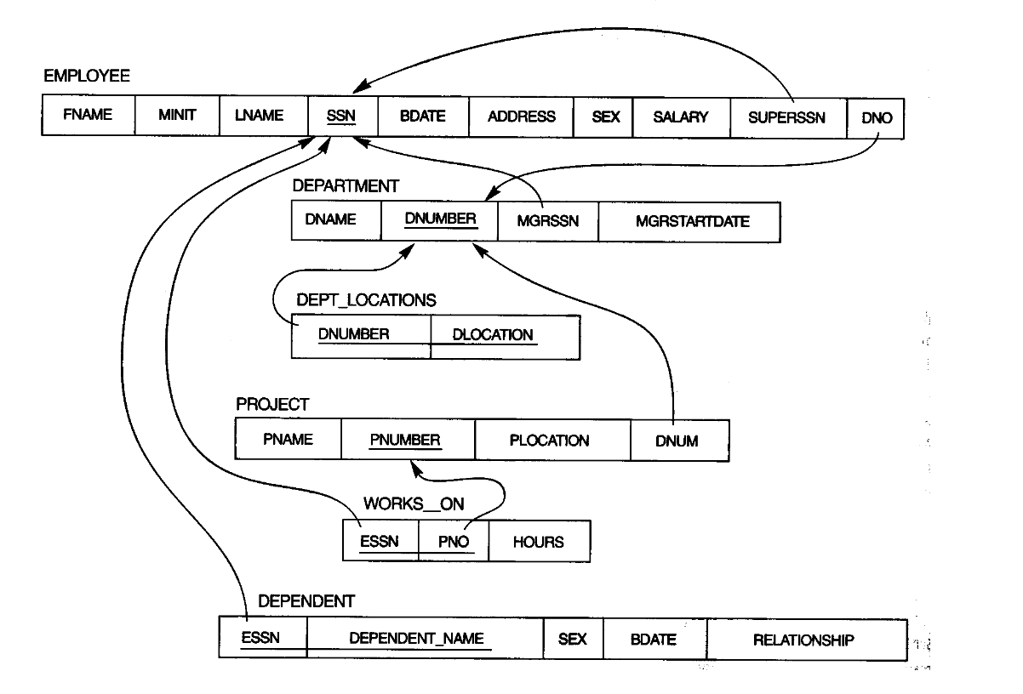
Interpret this!

